Slide 1
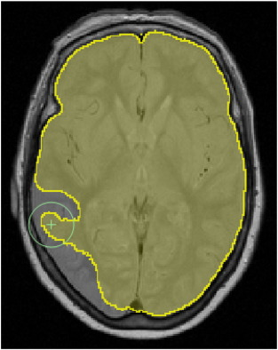
DETECTING EARLY ALZHEIMER'S USING MRI DATA AND MACHINE LEARNING
Team Members:
Peter Shyamal
Abirami
Madhumitha
Mohan Deep
Harishiva

Slide 2
Problem Statement
- Alzheimer's disease (AD) is a neurodegenerative disorder of uncertain cause and pathogenesis that primarily affects older adults and is the most common cause of dementia. - The earliest clinical manifestation of AD is selective memory impairment and while treatments are available to ameliorate some symptoms, there is no cure currently available. - Brain Imaging via magnetic resonance imaging (MRI), is used for evaluation of patients with suspected AD. - MRI findings include both, local and generalized shrinkage of brain tissue. - Some studies have suggested that MRI features may predict rate of decline of AD and may guide therapy in the future. - However in order to reach that stage clinicians and researchers will have to make use of Machine learning techniques that can accurately predict progress of a patient from mild cognitive impairment to dementia. - We propose to develop a sound model that can help clinicians do that and predict early alzheimer's.

Slide 3
DATASET DESCRIPTION
- We will be using the longitudinal MRI data.
- The dataset consists of a longitudinal MRI data of 150 subjects aged 60 to 96.
- Each subject was scanned at least once.
- Everyone is right-handed. - 72 of the subjects were grouped as ‘Nondemented' throughout the study.
- 64 of the subjects were grouped as 'Demented' at the time of their initial visits and remained so throughout the study.
- 14 subjects were grouped as ‘Nondemented' at the time of their initial visit and were subsequently characterized as 'Demented' at a later visit. These fall under the 'Converted' category.

Slide 4
COLUMN DESCRIPTORS
EDUC - Years of education
SES - Socioeconomic Status
MMSE - Mini Mental State Examination
CDR - Clinical Dementia Rating
eTIV - Estimated Total Intracranial Volume
nWBV - Normalize Whole Brain Volume
ASF - Atlas Scaling Factor

Slide 5
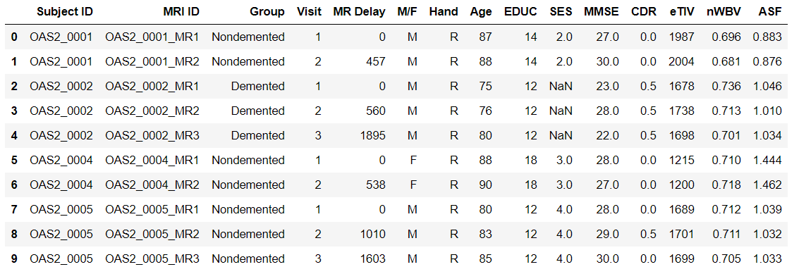
Reading the Data
df=pd.read_csv('oasis_longitudinal.csv')
df.head(10)

Slide 6
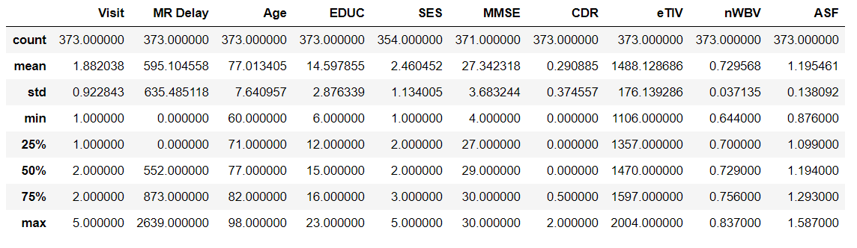
Summary statistics
df.shape()
(373,15)
df.describe()

Slide 7
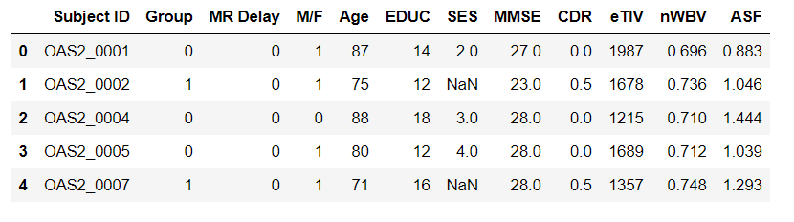
CODE:
df = df.loc[df['Visit']==1] # use first visit data only because of the analysis we're doing df = df.reset_index(drop=True) # reset index after filtering first visit data df['M/F'] = df['M/F'].replace(['F','M'], [0,1]) # M/F column df['Group'] = df['Group'].replace(['Converted'], ['Demented']) # Target variable df['Group'] = df['Group'].replace(['Demented', 'Nondemented'], [1,0]) # Target variable df = df.drop(['MRI ID', 'Visit', 'Hand'], axis=1) # Drop unnecessary columns
-we have changed the values of Gender to 0,1 - we have changed the targer value to 0,1 - we have dropped the MRI ID,Visit,Hand columns

Slide 8
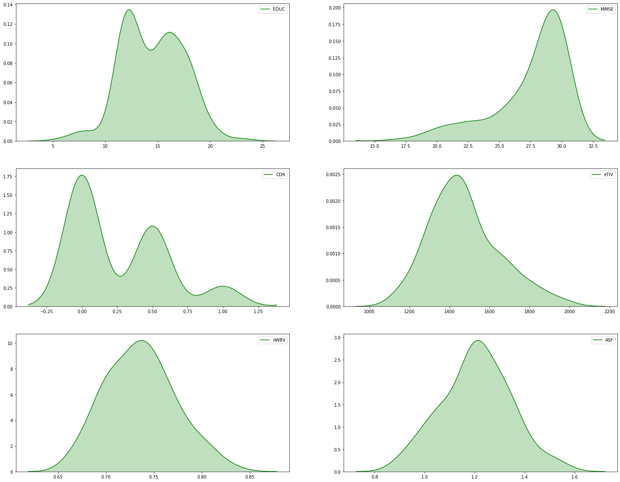
Distribution of independent variables

Slide 9
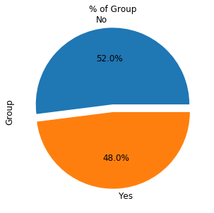
Key Inference
The chart indicates that almost half of the patients, visiting for the first time are detected with Alzheimer.

Slide 10
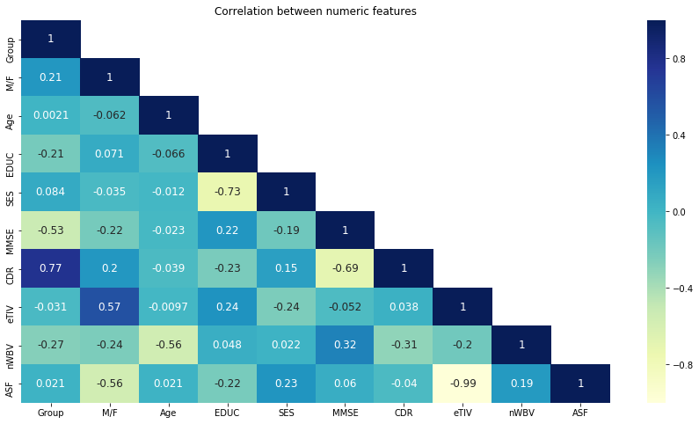

Slide 11
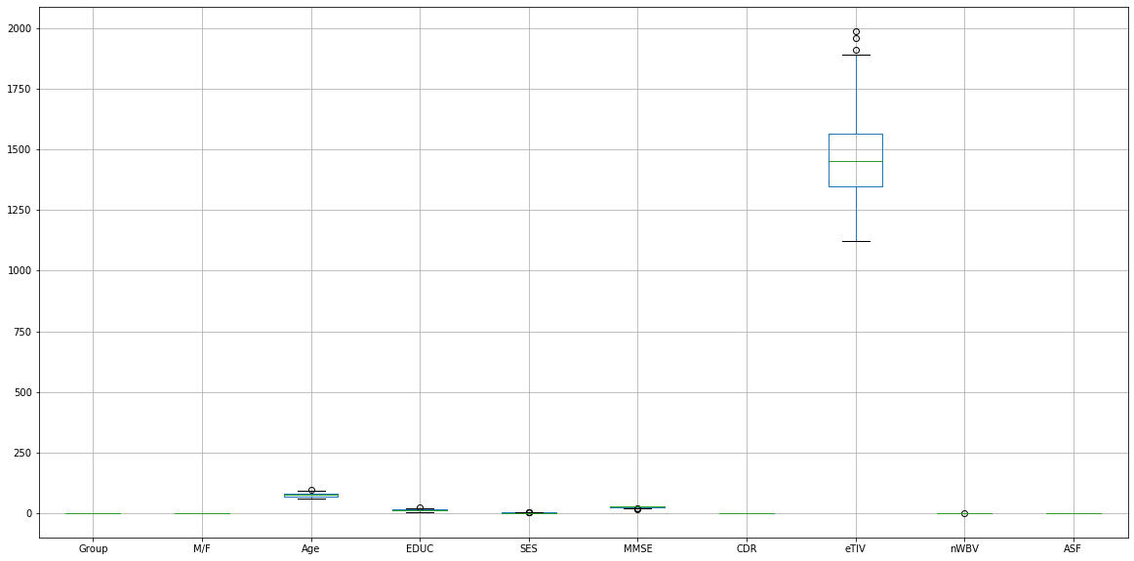

Slide 12
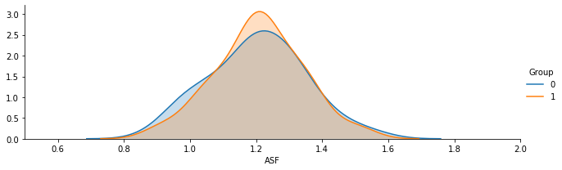
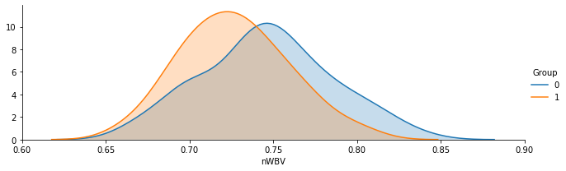
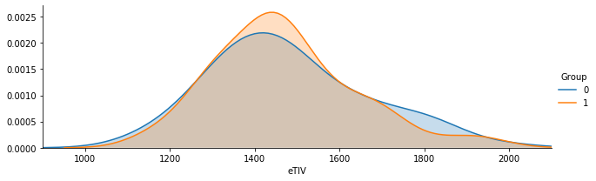
Distribution of independent variables classified by Dependent variables

Slide 13
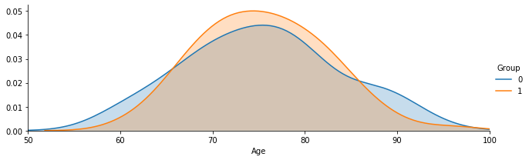
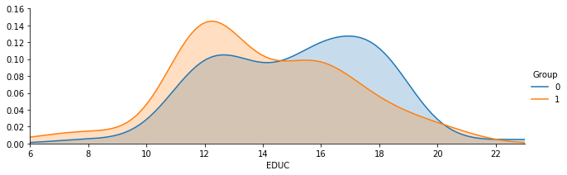
Contd..

Slide 14
INTERMEDIATE INFERENCES
The Nondemented group has higher brain volume ratio than Demented group. This is assumed to be because the diseases affect the brain to be shrinking its tissue.
There is a higher concentration of 70-80 years old in the Demented patient group than those in the nondemented patients. We guess patients who suffered from that kind of disease has lower survival rate so that there are a few of 90 years old.
Men are more likely with demented, an Alzheimer's Disease, than Women.
Demented patients were less educated in terms of years of education.
Nondemented group has higher brain volume than Demented group.
Higher concentration of 70-80 years old in Demented group than those in the nondemented patients

Slide 15
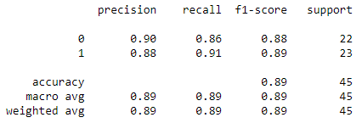
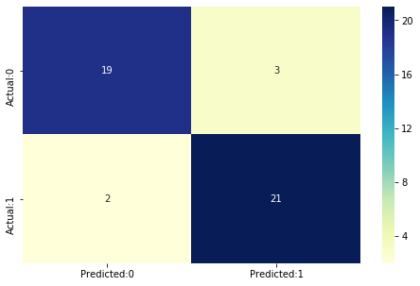
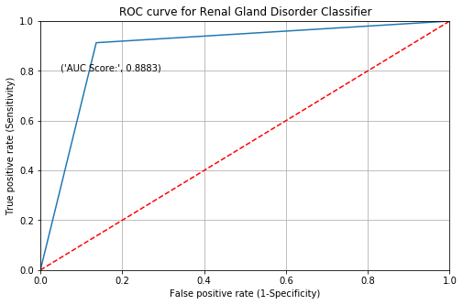
Logistic Regression (MLE with Scaled Features)

Slide 16
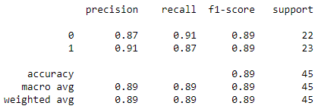
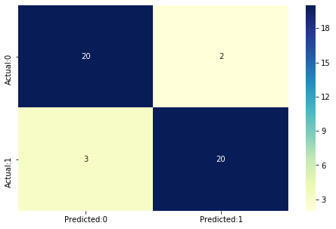
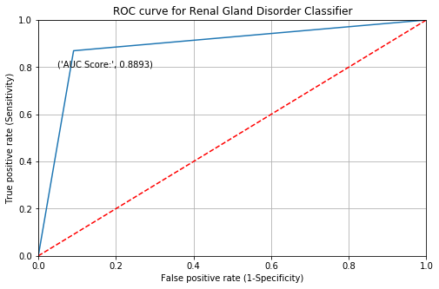
Logistic Regression (MLE without Scaled)

Slide 17
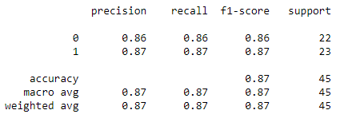


Logistic Regression (using SGD)

Slide 18
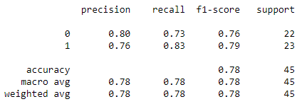
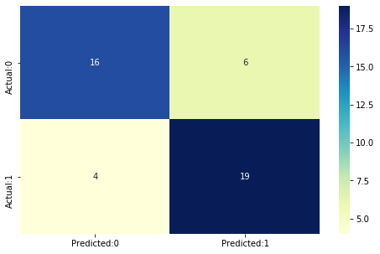
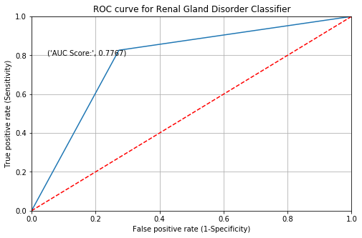
Decision Tree

Slide 19
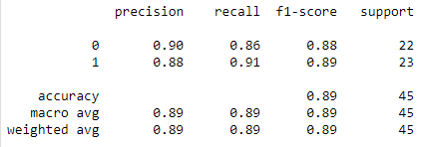
Decision Tree Pruned

Slide 20
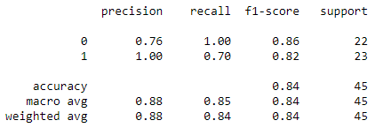
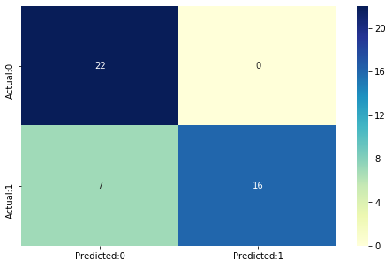
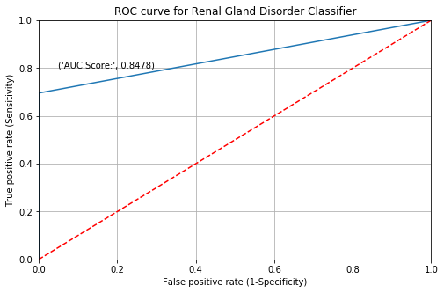
Decision Tree (using GridSearchCV)

Slide 21
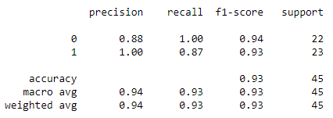
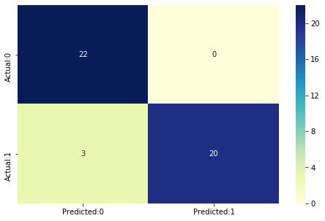
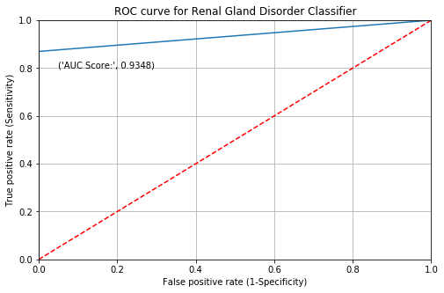
SVM

Slide 22
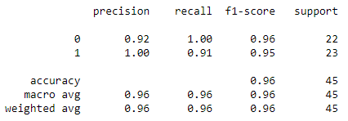

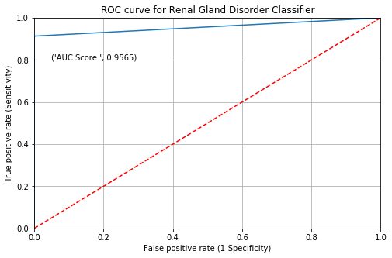
Random Forest Classifier

Slide 23
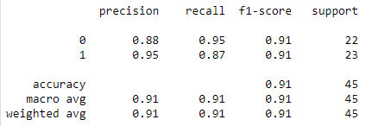


XGB Classifier

Slide 24
Metrics Tabulation
Model | AUC Score | Precision Score | Recall Score | Accuracy Score | f1-score
Logistic regression (ScaledFeatures) | 0.88834 | 0.875 | 0.913043 | 0.888889 | 0.893617
Logistic regression (Without ScaledFeatures) | 0.889328 | 0.909091 | 0.869565 | 0.888889 | 0.888889
Logistic regression (SGD) | 0.866601 | 0.869565 | 0.869565 | 0.866667 | 0.869565
Decision Tree | 0.77668 | 0.76 | 0.826087 | 0.777778 | 0.791667
Pruned Decision Tree | 0.88834 | 0.875 | 0.913043 | 0.888889 | 0.893617
Decision Tree (GridSearchCV) | 0.847826 | 1 | 0.695652 | 0.844444 | 0.820513
SVM (GridSearchCV) | 0.934783 | 1 | 0.869565 | 0.933333 | 0.930233
RandomForest | 0.956522 | 1 | 0.913043 | 0.955556 | 0.954545
XGBClassifier | 0.912055 | 0.952381 | 0.869565 | 0.911111 | 0.909091

Slide 25
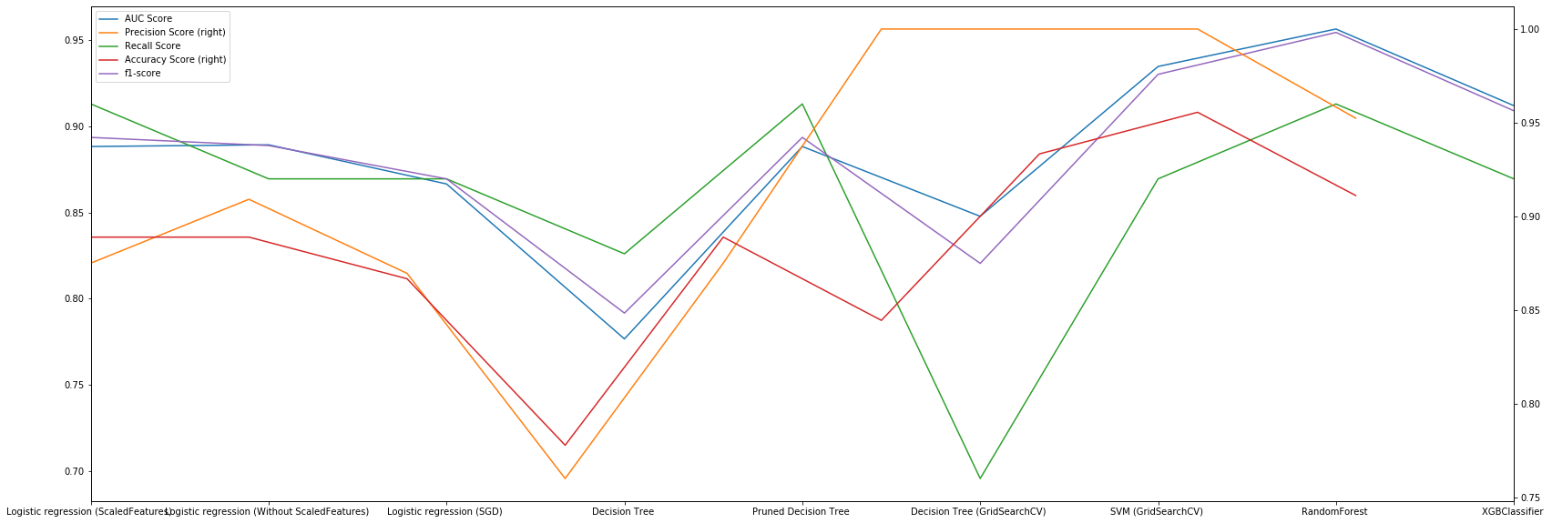
Metrics Plot

Slide 26
Conclusion
It can be noticed that our results are comparable and in certain cases better than those from the previous work. Our Support Vector Machine was one of the best performing model.
The idea is that a Clinician should be able to input MRI results, biographic data and other parameters for a patient. Our model should assist them in identifying dementia.

